Slide 1
Hioki vs CAN for 2017 prius prime

Slide 2
CDA Dataset checked for 2017 prius prime:
72403002-15 UDDS
72403017-26 US06
72403027-38 HWFET
Plot the linear fitting between
CAN voltage vs Hioki voltage
CAN current vs Hioki current
CAN active power vs Hioki active power
CAN integrated power vs Hioki integrated power

Slide 3
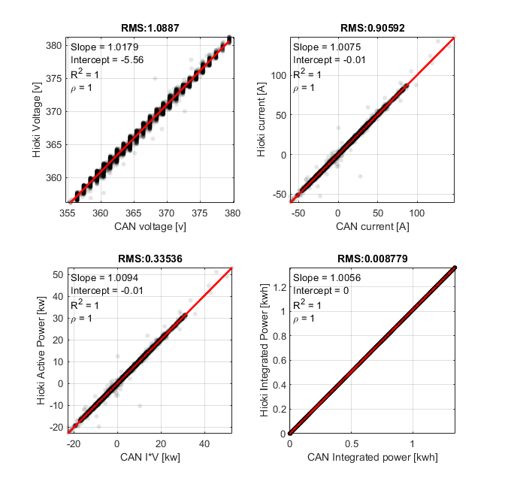
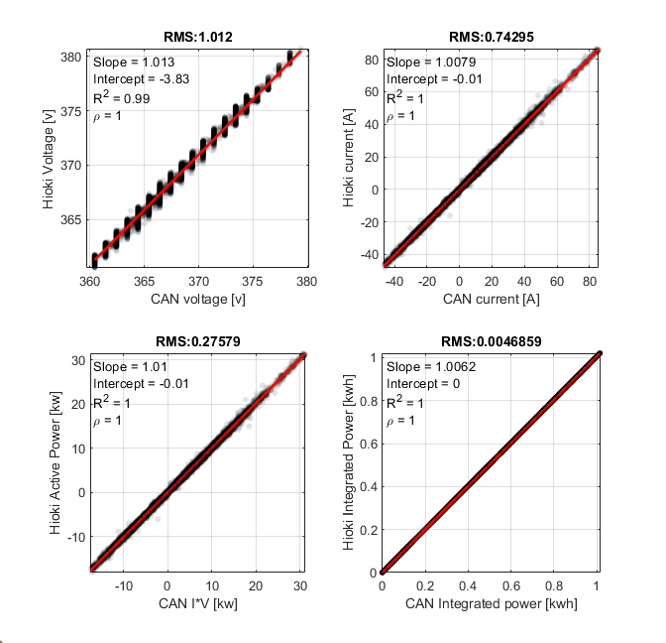
Test ID: 72403002
Test ID: 72403005

Slide 4
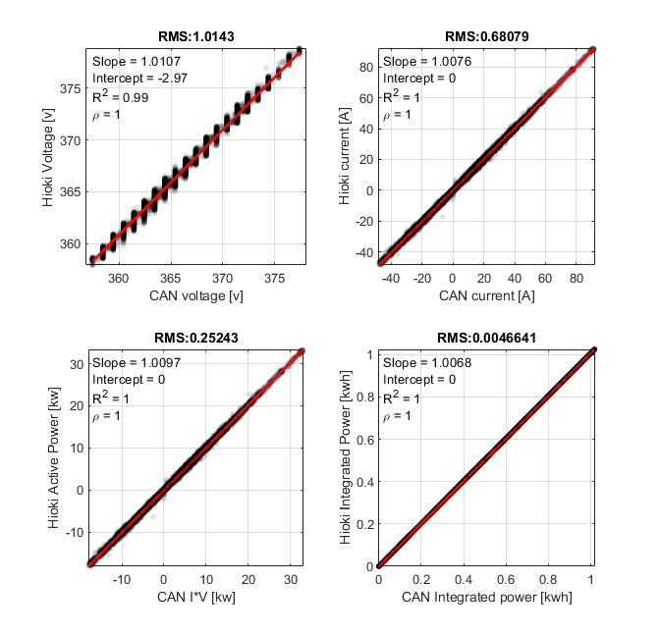
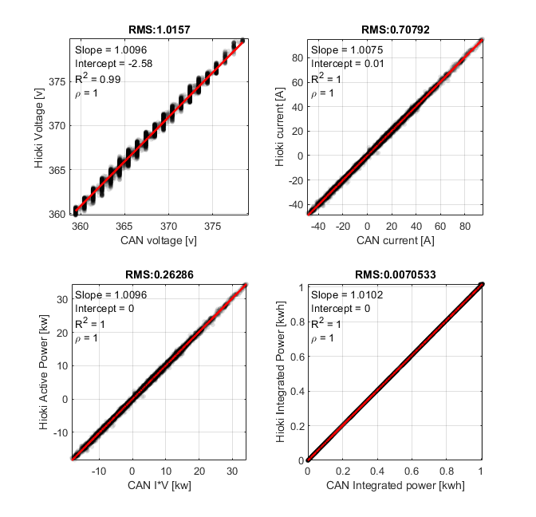
Test ID: 72403006
Test ID: 72403007

Slide 5
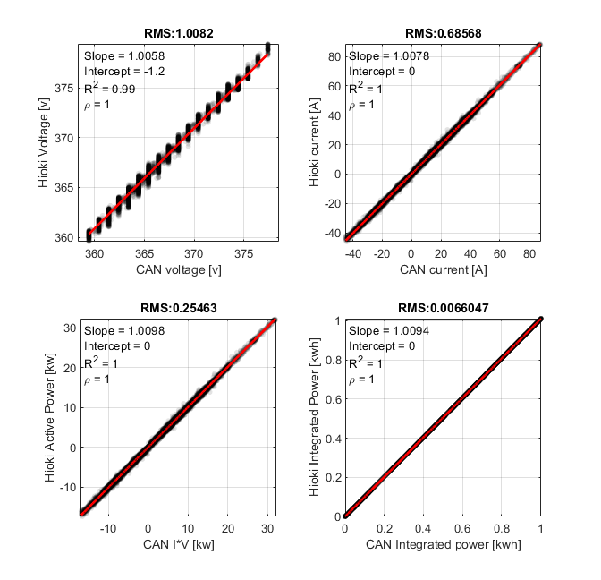
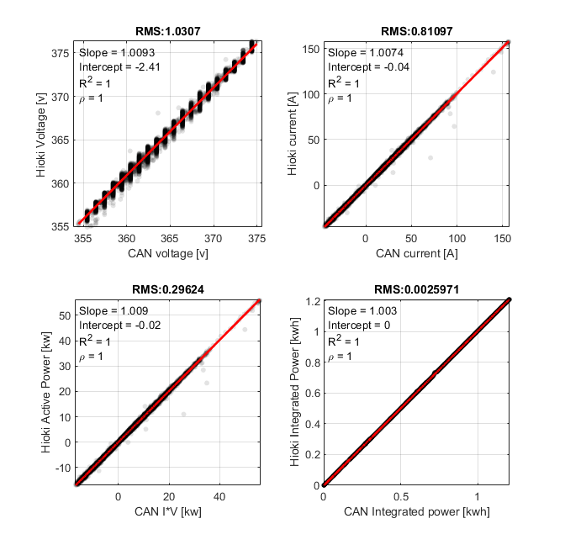
Test ID: 72403008
Test ID: 724030010

Slide 6
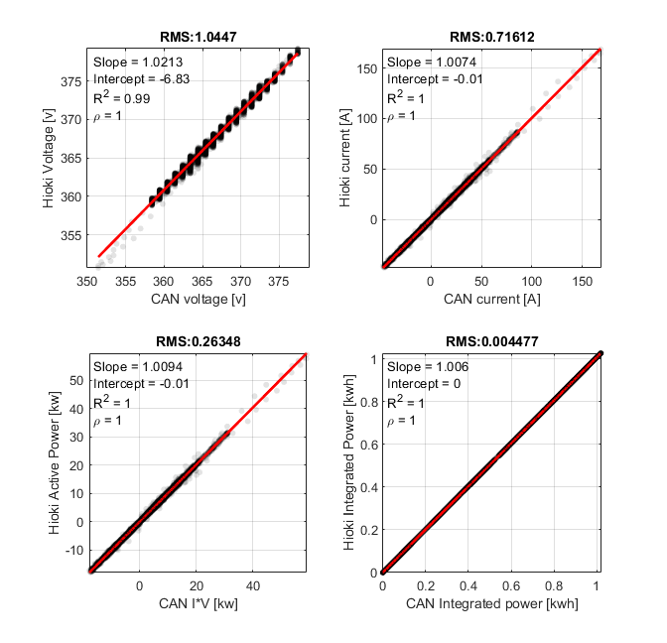
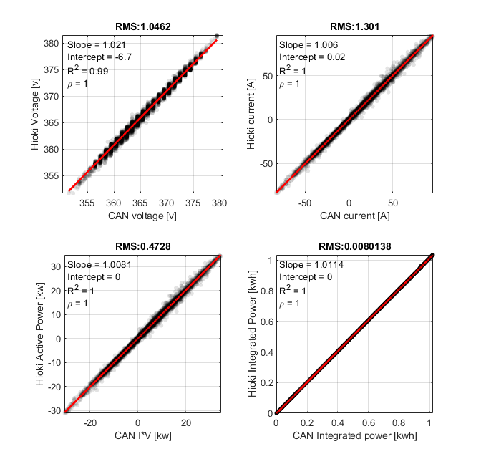
Test ID: 72403012
Test ID: 724030015

Slide 7
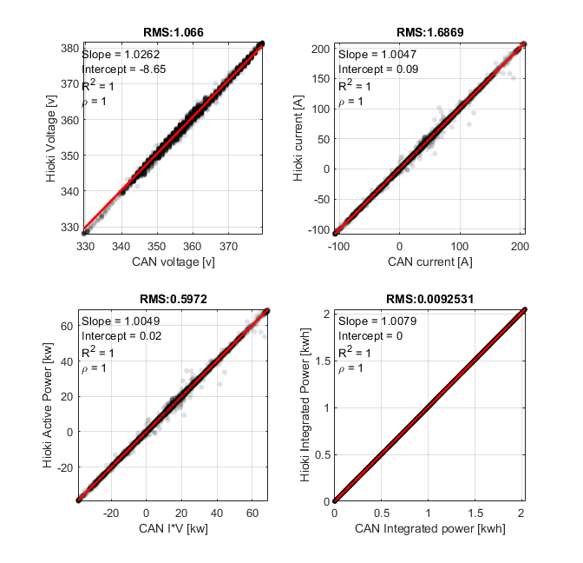
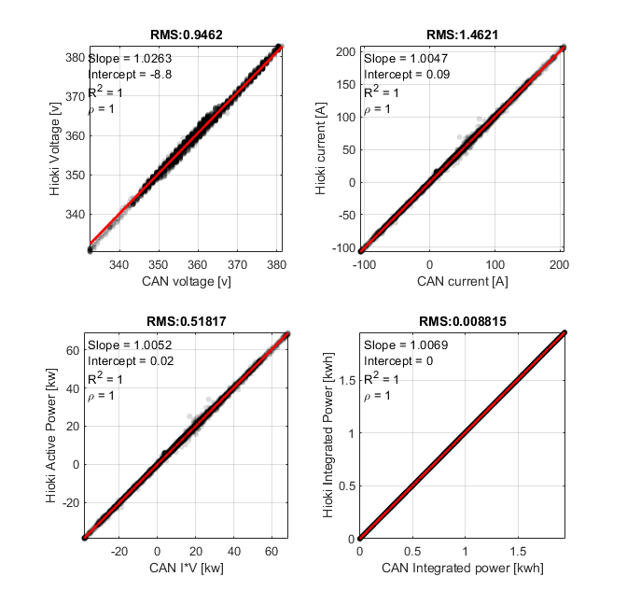
Test ID: 72403017
Test ID: 724030018

Slide 8
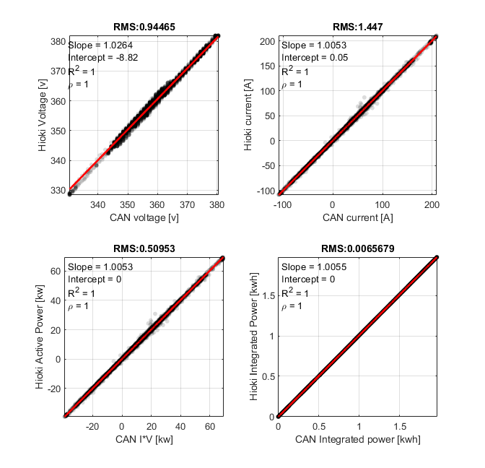
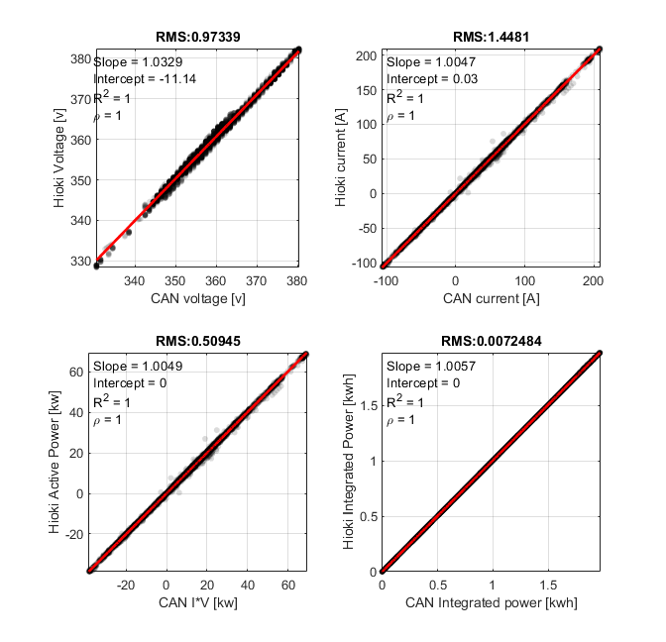
Test ID: 72403019
Test ID: 724030020

Slide 9
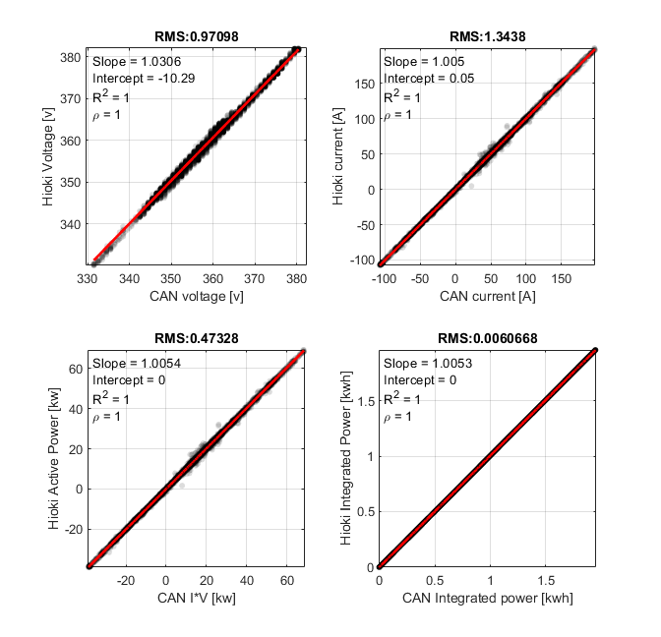
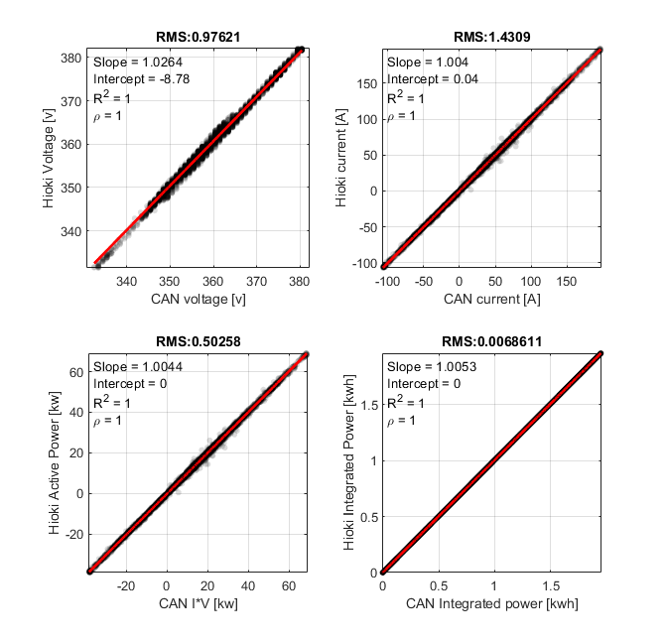
Test ID: 72403021
Test ID: 724030022

Slide 10
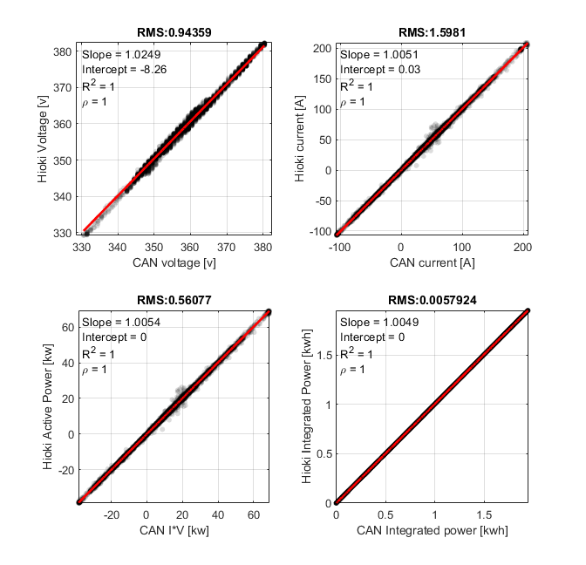
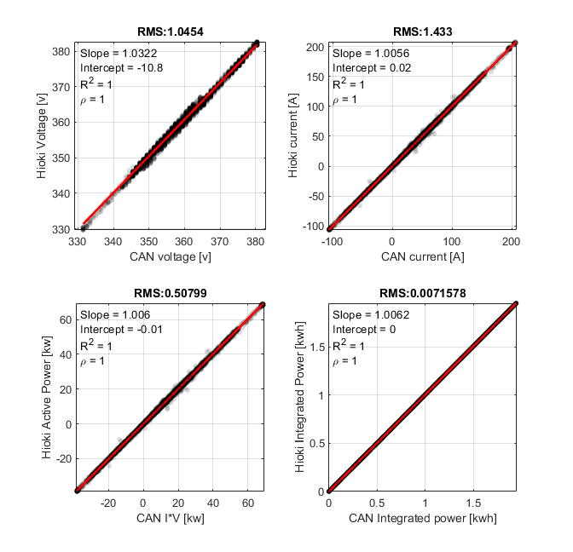
Test ID: 72403023
Test ID: 724030024

Slide 11
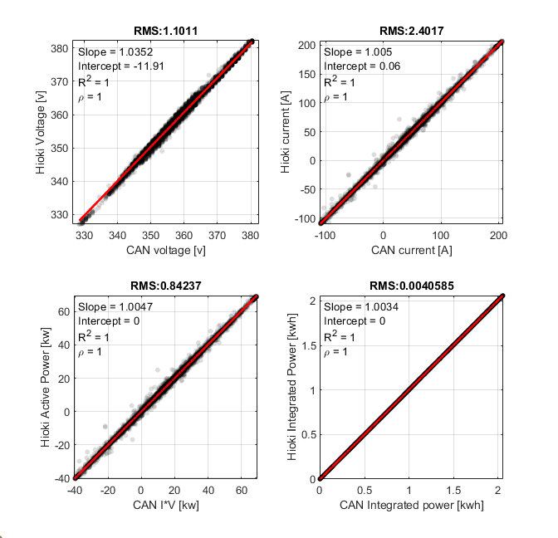

Test ID: 72403025
Test ID: 724030026

Slide 12
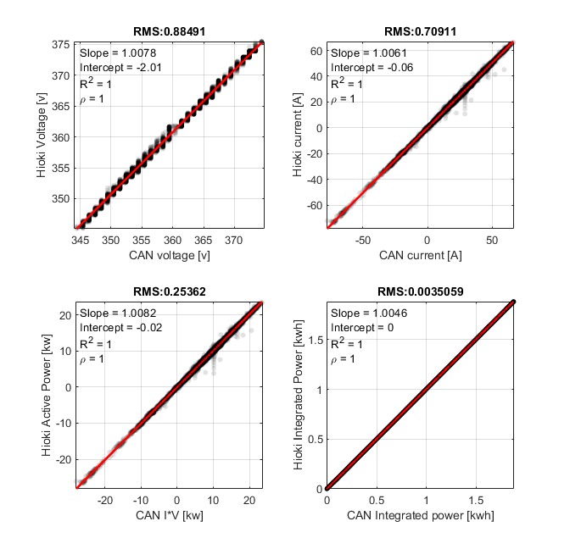
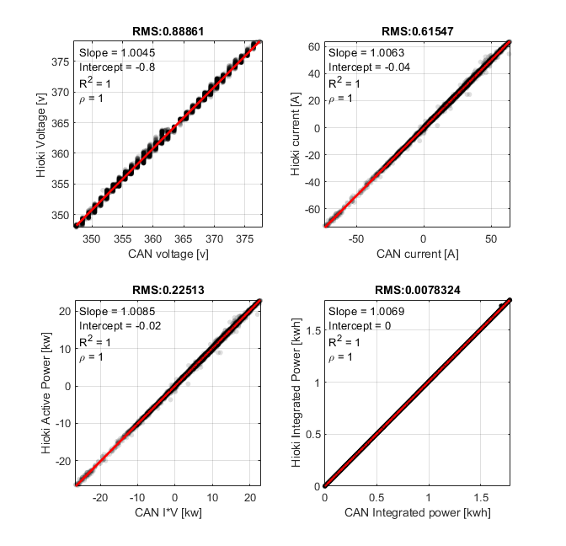
Test ID: 72403027
Test ID: 724030028

Slide 13
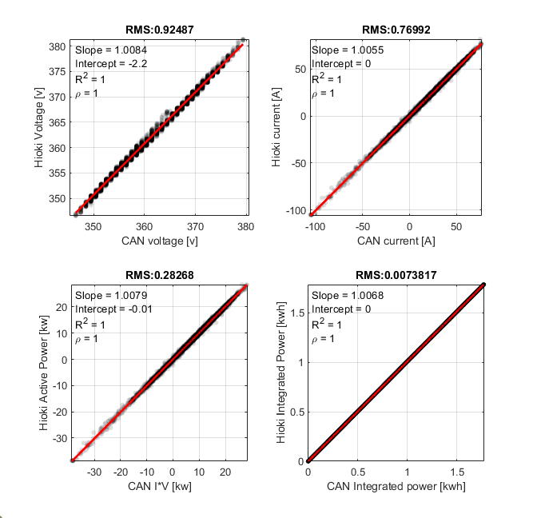
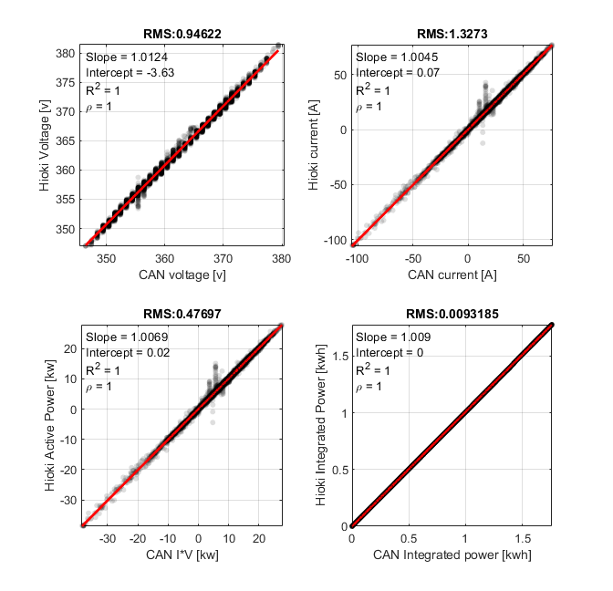
Test ID: 72403029
Test ID: 72403030

Slide 14
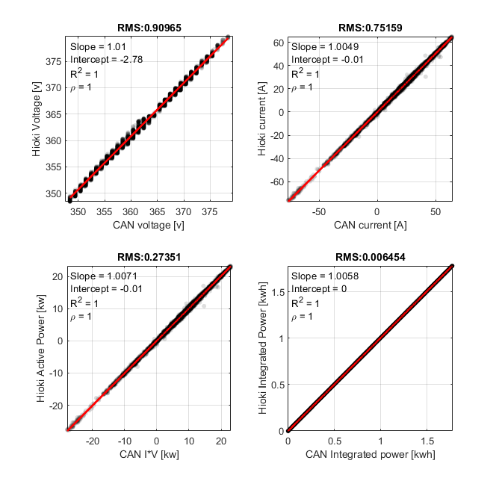
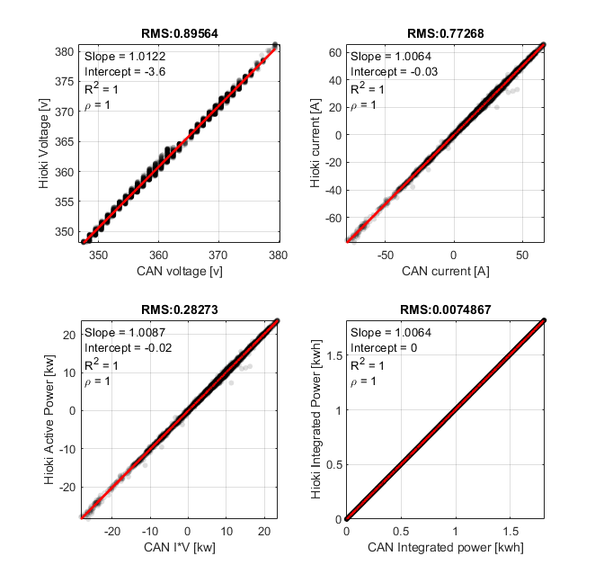
Test ID: 72403031
Test ID: 72403032

Slide 15
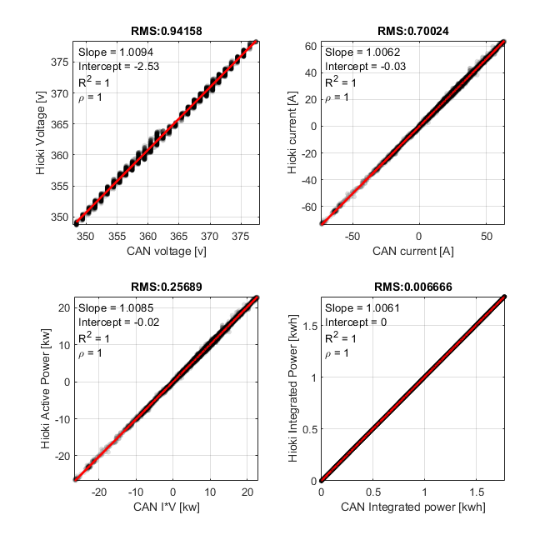
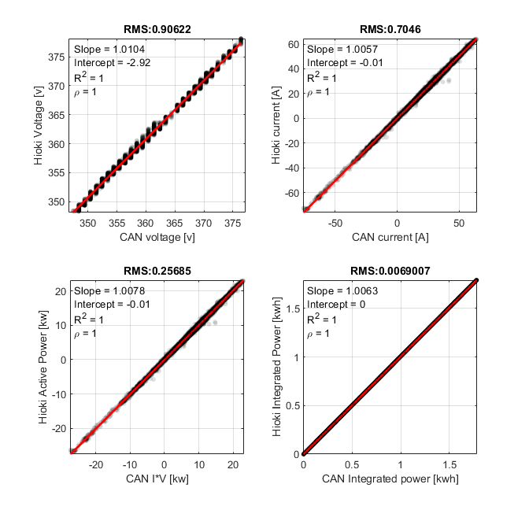
Test ID: 72403033
Test ID: 72403034

Slide 16
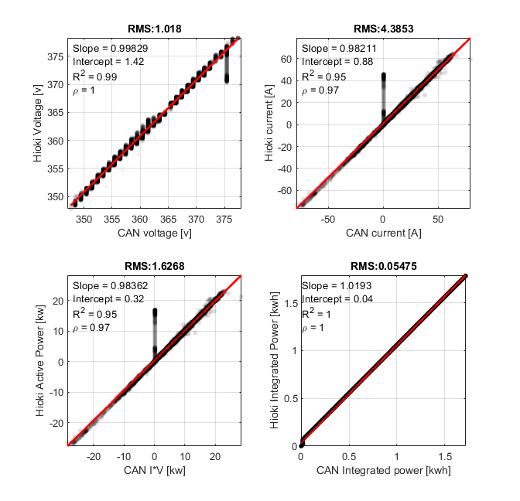

Test ID: 72403035
Test ID: 72403036

Slide 17
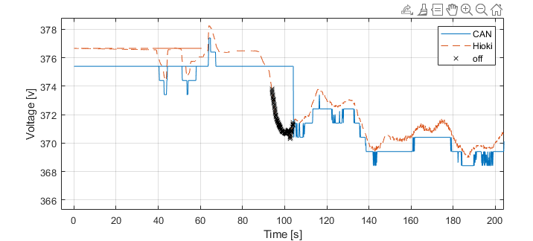
Test ID: 72403035

Slide 18
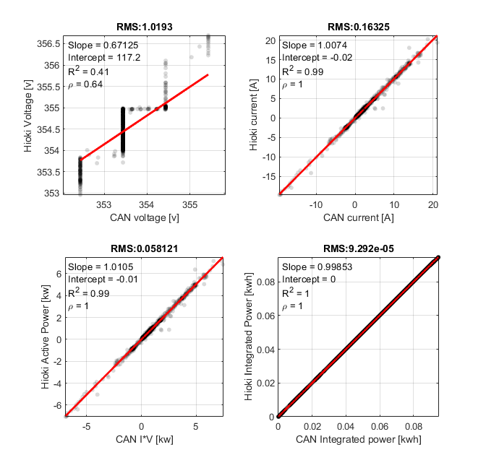
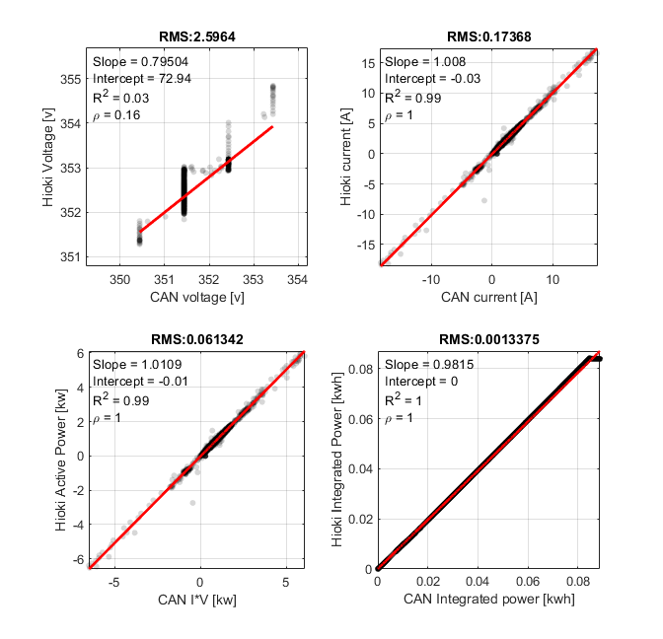
Test ID: 72403037
Test ID: 72403038

Slide 19
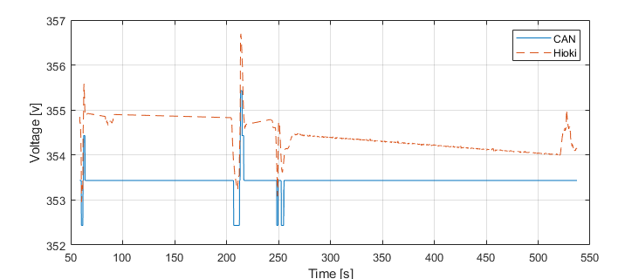
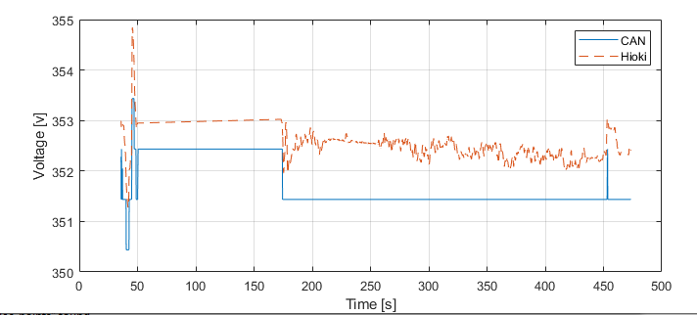
Test ID: 72403037
Test ID: 72403038

Slide 20
Conclusion
There may be some discrepancy in voltage measurement due to the ‘slow’ update in CAN bus.
Overall, current and active power measurement is very close
The difference in integrated power is negligible.

Slide 21
Hioki vs CAN 2019 Nissan leaf
Combine MCT 62007023 + 62007024 + 62007025 + 62007026 (Miriam)
CAN current measurement has the opposite sign of Hioki current measurement
HEV _receive, BECM _receive, MCM _receive, ABS_receive, CCM _receive are all seems DIANOSTIC signals. So we use the CAN5 signals: HVBatt_voltage_CAN5__V, HVBatt_current_wide_CAN5__A
Hioki has 8 sets of measurement, u1 and u5,6,7,8 has the same scale as High voltage measurement, u3 ~ 250v (idk whats this). u2 and u4 are 12v batt. I2 to I8 (current) values are low, only I1 is in the right scale as Hvbatt CAN5 current data, we will compare these two values then

Slide 22
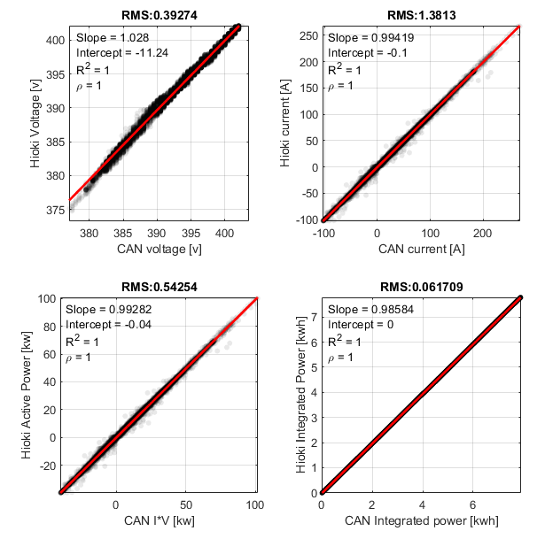
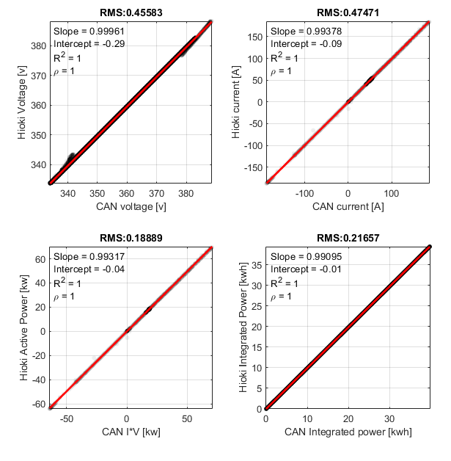
62007023
62007024

Slide 23
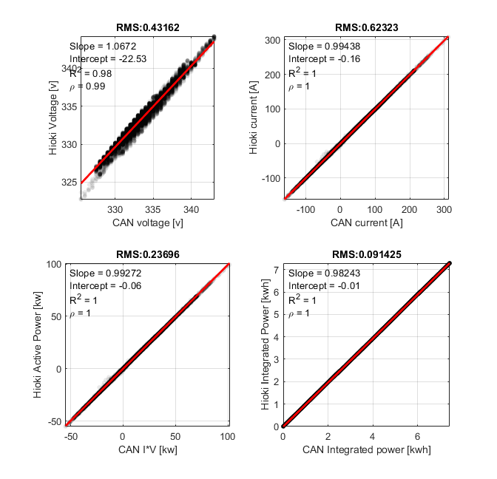
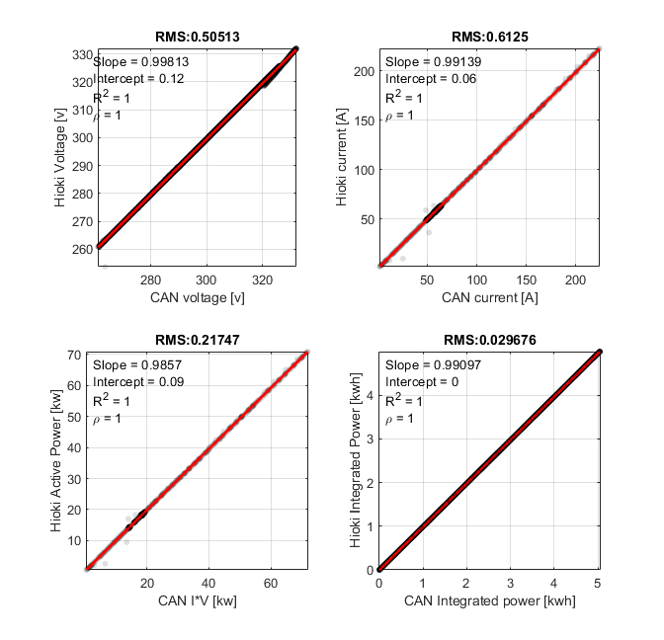
62007025
62007026

Slide 24
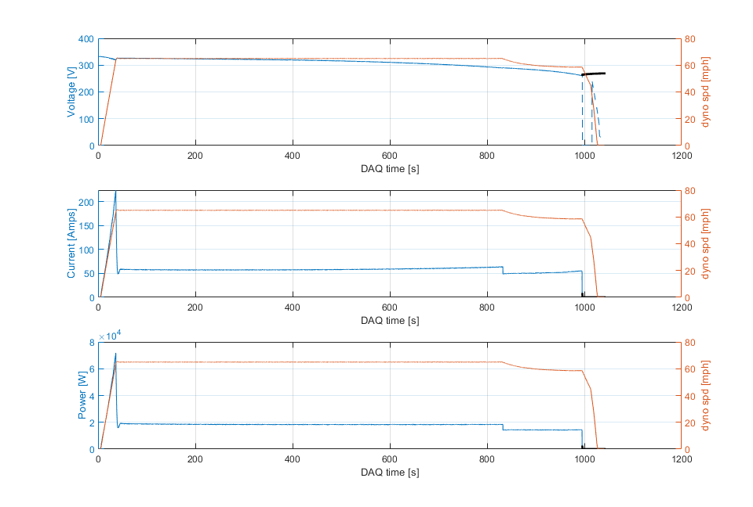
Linear correlation was performed by removing some obvious outliers. Take 62007026 as example. There is a huge disagreement between CAN and Hioki measurement when vehicle reduces speed to zero (See below)

Slide 25
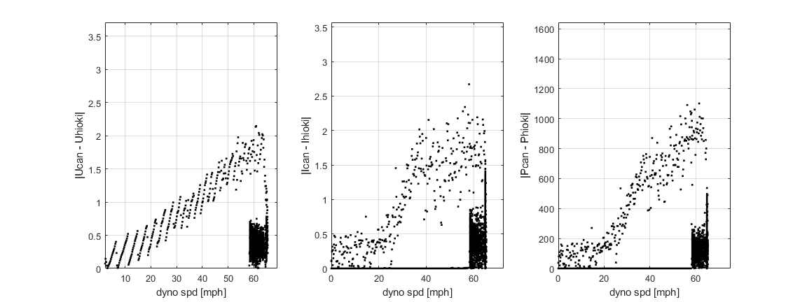
Also take 62007026 as example. What’s the correlation between measurement difference and vehicle speed?

